Slide 1
System Models

Slide 2
Short recap on previous lesson
In our previous lesson, we explored some various software process models to describe how software is planned, developed, and delivered. Before we move to our new chapter “system model”, I would like to introduce additional software model “Spiral Model”. This model combines features of both iterative and waterfall models. It emphasizes risk analysis, prototyping, and repeated refinement through multiple cycles (or spirals), making it suitable for large, complex, and high-risk projects.
As we move forward, today’s lesson will focus on the System Model, where we look at how system components and their interactions are represented to understand and design complete systems effectively.

Slide 3
Spiral Model
The spiral model is a risk-driven software development process that combines iterative and linear (waterfall) approaches.
It's ideal for large, complex, and high-risk projects because each cycle, or "loop," of the spiral is a distinct phase that involves planning, risk analysis, engineering (development), and evaluation.
This structure allows for risk management, customer feedback, and incremental or prototype development throughout the project lifecycle.

Slide 4
How spiral model combine iterative and linear (waterfall) approaches
The spiral model combines the iterative nature of the iterative model with the structured, controlled phases of the waterfall model by using repetitive cycles (spirals) that incorporate the linear phases of waterfall (planning, risk analysis, engineering, evaluation) for risk management and incremental development.
Each spiral builds upon the previous one, allowing for continuous refinement and risk mitigation, which results in incremental releases or prototypes until the final product is complete.

Slide 5
How spiral model combine iterative and linear (waterfall) approaches cont.
Sequential phases within each spiral: Each cycle of the spiral contains the structured, linear phases found in the waterfall model, including identification, risk analysis, engineering, and evaluation.
Iterative refinement: The product is not built all at once. Instead, the project moves through multiple iterations or "spirals," with each spiral adding functionality and refinement to the previous one.

Slide 6
How spiral model combine iterative and linear (waterfall) approaches cont.
Risk management: The key combination is using the iterative cycles to address risks before they become major problems. The risk analysis phase in each spiral is critical, and may lead to building a prototype or other risk-mitigation activities within that specific cycle.
Incremental development: The model allows for incremental releases of the product, with each completed spiral resulting in a more developed version of the software, until the final product is ready.

Slide 7
Spiral Model
The spiral model was originally proposed by Boehm (1988).
Rather than represent the software process as a sequence of activities (linier model) with some backtracking (a problem-solving method that builds a solution incrementally and abandons a candidate path as soon as it determines the candidate cannot possibly be completed to a valid solution) from one activity to another, the process is represented as a spiral.
Each loop in the spiral represents a phase of the software process.
Thus, the innermost loop might be concerned with feasibility study, the next loop with requirements analysis and definition, the next loop with system and software design and so on.
The each loop in the spiral is split into four sectors as indicated in the next slid.

Slide 8
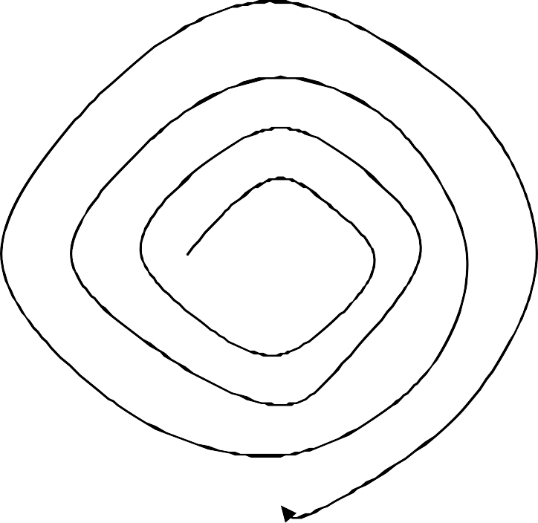
Determine objects, alternatives and constrains
Evaluate alternatives, identify, and resolve risks
Develop, verify next- level product
Plan next phase

Slide 9
Spiral Model (Cont…)
Objective setting:
A cycle of the spiral begins by determining special objectives for that phase of the project.
Constrains and the product are identified and a detailed management plan
is drawn up. Project risks are identified.
Alternative strategies and ways of achieving these objectives, depending on those risks, may be planned.
Risk assessment and reduction:
For each of the identified project risks, a detailed analysis is carried out.
Steps are taken to reduce the risk.
For example, if there is a risk that the requirements are inappropriate, a prototype system may be developed.

Slide 10
Spiral Model (Cont…)
Development and validation:
After risk evaluation, a development model for the system is
then chosen.
For example, if user interface risks are dominant, an appropriate
development model might be prototyping.
If main risk is sub-system integration, the waterfall model is the most appropriate process model.
Planning:
The project is reviewed and a decision made whether to
continue with a further loop of the spiral.
– If it is decided to continue, plans are drawn up for the next phase of the project. If it is decided to stop, the software product is released.

Slide 11
Examples of the system with spiral model
Example is complex healthcare patient management system, which starts with basic features and adds more complexity over several iterations based on risk assessment and user feedback.
Other examples include the development of large-scale software like early Windows versions and the iterative creation of video games, where customer feedback guides improvements over time.

Slide 12
Example: new patient management system in healthcare
Spiral 1: Planning and Risk Analysis. The project begins by defining core features like user authentication and data entry. Risks, such as data privacy and system compatibility, are identified.
Spiral 1: Engineering and Evaluation. A basic version is developed. The team evaluates it with initial users to gather feedback and assess risks.
Spiral 2: Planning and Risk Analysis. Based on feedback, the next iteration plans to add features like appointment scheduling and billing. New risks associated with these features are analyzed.

Slide 13
Example: new patient management system in healthcare
Spiral 2: Engineering and Evaluation. The system is updated to include the new features. The process repeats, with evaluation including user feedback to guide the next cycle.
Subsequent spirals: This iterative process continues until the system meets all requirements, with each cycle building upon the last and refining the system based on user input and risk management.

Slide 14
System Models

Slide 15
(1) System Modelling
A system model is an abstract representation of a (software) system used to understand, analyze, and communicate its structure, behavior, and functionality
These models are often graphical, utilizing notations like the Unified Modeling Language (UML), to provide different perspectives such as external, structural, and behavioral.
Models help in requirements gathering and design, allowing teams to explore ideas without writing code and serve as blueprints for developers.
Numerous methods have been developed in order to solve the software crisis for decades. In this chapter, we oversee several widely-known methods of software engineering.

Slide 16
(1) System Modelling (Cont…)
User requirements should be written by natural language because they should be understood by clients who are not technical experts on software development.
However, more detailed system requirements should be described by using more systematic and technical methods.
System modeling is a widely used technique to document the system specification.
System models are graphical representations that express the existing business processes, the problems to be solved, and the system to be developed.
Since they are graphical representations, they are more understandable than natural language descriptions of system requirements.
They can be used as bridge between analysis and design phases.

Slide 17
Types of System models
Structural Models: These models describe the static structure of the system, showing how different components are organized and related. Examples include class diagrams and component diagrams.
Behavioral Models: These illustrate how the system behaves and responds to stimuli. They can be data-driven or event-driven and include techniques like state machine and activity diagrams.
External/Context Models: These models show the system's interaction with its environment, often using diagrams like use case diagrams to represent how users or other systems interact with it.

Slide 18
A. Context models
At an early stage in the user requirements and analysis process you should decide on boundaries of the system (the conceptual or physical limits that define what is inside a system and what is outside in its environment).
– It is important to distinguish what is the system and what is the system’s environment in order to limit the costs and times needed for analysis.

Slide 19
Context models cont.
A context model describes the operational context of a system — that is, all external systems, users, and factors that influence or are influenced by the system.
It helps to understand what lies inside and outside the system boundaries (Define what is internal (the system) and external (the environment).
The system is usually shown as a single process (a central box) with arrows indicating data or control flow between the system and external entities.
Its purpose:
To clarify system boundaries — what the system will and will not do.
To identify all external interfaces and interactions.
To communicate scope and dependencies to stakeholders.
To serve as a foundation for requirement elicitation and system architecture design.

Slide 20
Context models cont.
Elements of a Context Model
Element | Description
System (Process) | The main system being developed (represented as a single box).
External Entities (Actors) | People, other systems, or organizations interacting with the system.
Data Flows / Interfaces | Information, messages, or material exchanged between the system and external entities.
Boundaries | Define what is internal (the system) and external (the environment).

Slide 21
Context models cont.
Example of a Context Model : A University Course Registration System
External entities:
Students
Academic Staff
Payment Gateway
University Database
Data Flows:
Students → Submit registration requests
System → Sends payment requests to gateway
Gateway → Sends payment confirmation
Staff → Upload course information
In a context diagram, you would draw:
A central box labeled Course Registration System
External entities as ovals around it
Arrows showing data flow between them

Slide 22
Context models cont.
Example of a Context Model : A University Course Registration System
Benefits
Simplifies communication with non-technical stakeholders.
Provides an overview before detailed design.
Helps to identify integration points and dependencies early.
Acts as a baseline for requirement validation.
Limitations
It does not describe internal details of the system.
It omits timing, performance, and logic aspects.
As a static model, it must be updated regularly to reflect system evolution.

Slide 23
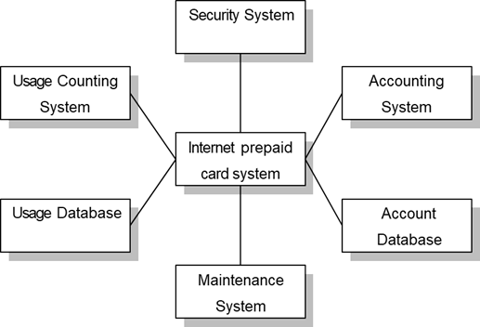
The context of an Internet prepaid card system
https://creately.com/guides/context-diagram-tutorial/
Above figure is a context model that illustrates the structure of the Internet prepaid card system.
High-level context morels are usually expressed as simple block diagrams where each sub-system is represented by a named rectangle, and lines indicate associations between sub-systems.
However they do not show the relationship between the other systems in the environment and the
system being specified.
Therefore, simple context models are normally supplemented by other methods, such as behavioral models explained in the following section.

Slide 24
B. Behavioural Model
Behavioral models are used to describe the overall behavior of the system.
Describes how a system behaves or reacts to external and internal events during its operation.
Focuses on the dynamic aspects of a system — that is, how the system changes its state over time and how it interacts with users, other systems, and data.
– There are two types of behavior models: data-flow models, which model the data processing in the system, and the state machine models, which model how system reacts to the incoming events.

Slide 25
Depending on the type of system, these models may be used separately or together.
Generally, most business systems are driven by data so a data- flow model may be useful to represent the behavior of these systems.
In contrary, real-time systems are often driven by event with minimal data processing.
The state machine models are most effective way to represent their
behavior.
Other types of systems may be both data and event driven. In these cases, you need to develop both types of models.

Slide 26
Example of Behavioural Model
For an Online Payment System, a behavioural model could include:
Use case: “Process Payment.”
Sequence diagram: showing communication. between User → Payment Gateway → Bank → Confirmation System.
State diagram: showing states like Payment Initiated → Processing → Approved/Declined.

Slide 27
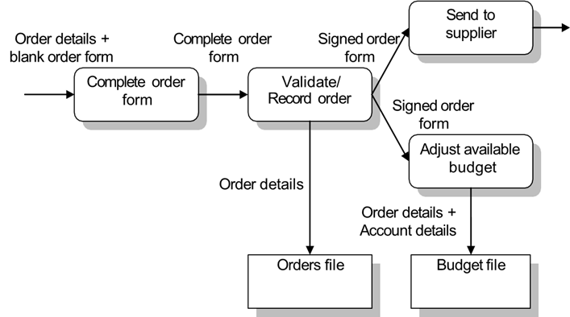
Example of Data-flow diagram of order processing

Slide 28
Figure shows
simple data-flow diagram of order
processing system such as personal computer procurement.
The notation used represents functional processing (rounded rectangles), data store (rectangles), and data movements between functions (labeled arrows).
Data-flow models are valuable because tracking and documenting how the data moves through the system helps analysts understand what is going on.
In principle, the development of models should be a top-down process starting from overall process to sub-processes.

Slide 29
Comparison between System Context Diagram and Data Flow Diagram
System Context Diagram: Provides an overview of the system and is the highest level representation in a data flow diagram. It focuses on the interaction of external entities with the system and contains only one process or program that represents the entire system. It is sometimes called a level 0 data flow diagram.
Data Flow Diagram: A graphical representation of the data "flow" of an information system that details the flow, processing, and storage of data in the system. It can be used to visualize the structured design of data processing and contains multiple levels of detail.
For more details
: https://www.processon.io/blog/how-to-create-a-system-context-diagram#:~:text=Definition%20and%20Overview,contains%20multiple%20levels%20of%20detail.

Slide 30
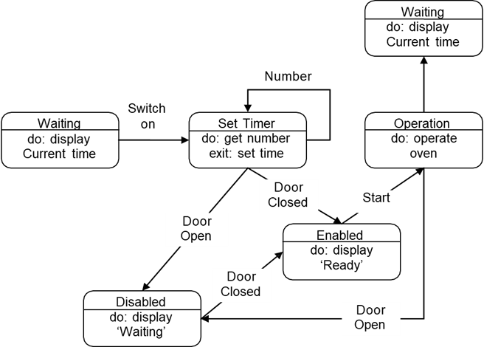
State machine model of a very simple microwave oven
A state machine models describe the behavior of a single object, specifying the sequence of events that an object goes through during its lifetime in response to events.

Slide 31
As an example, figure 8 shows a state machine model of a very simple microwave oven equipped with buttons to set power on and the timer and to start cooking.
– This microwave oven is in one of five states: ‘Waiting’, ‘Set Timer’, ‘Disabled’, ‘Enabled’, and ‘Operation’.
– It can respond to the events: ‘Switch on’, ‘Door Open’, ‘Door Closed’, ‘Start’, and ‘Number’. You can easily read the sequence of possible operations of this oven into this diagram, which is:
1. Put power on
2. Input cooking time
3. Press start, and the food is cooked for the given time.

Slide 32
C. Data Models
Almost all of large software systems make use of a database.
In some cases, database is independent of the software system.
In others, it is exclusively created for the system being developed.
An important part of systems modeling is defining the logical form of the data processed by the system.
The most widely used data modeling technique is Entity- Relationship (ER) modeling, which shows the data entities, their associated attributes and relations between these.

Slide 33
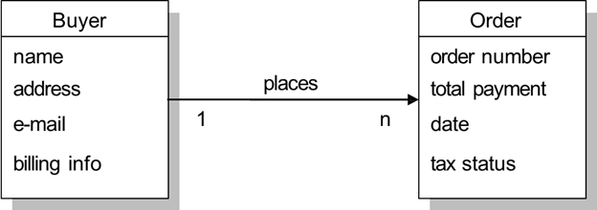
Simple ER diagram of order placing
Above figure shows simple ER diagram of order placing.
-It shows a buyer which has attribute ‘name’, ‘address’, ‘e-mail’, and ‘billing info’ places one or many order(s) which has ‘order number’, ‘total payment’, ‘date’, and ‘tax status’ as its attributes.

Slide 34
(2) Formal specification
A formal specification is a mathematical description of software and a formal method refers to mathematically based techniques for the specification, development and verification of software systems.
However, formal specification is an excellent way of discovering specification errors and presenting the system specification in an unambiguous way.
Organizations that have made the investment in formal methods have reported fewer
errors in the delivered software without increasing the development costs.
Formal methods are suitable to develop critical systems such as safety, reliability and security are very important. Critical systems where formal methods have been applied successfully include:
An air traffic control system
Railway signaling systems
Spacecraft systems
Medical control systems

Slide 35
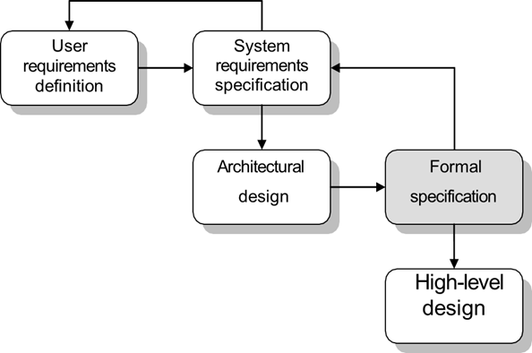
Formal Specification in the software process
Above Figure shows specification and design phase of software development process when formal specification is in use. If formal specification of the software is developed, this usually comes after the system requirements but before the detailed system design.
There is a tight feedback loop between the detailed requirements specification and the formal specification.

Slide 36
(3) Rapid software development
Since we are in globalization age in the form of an ever-increasing movement of people, goods, money, services and information across international borders, most businesses have to quickly respond to emerging markets, new opportunities, changing economic conditions and the competing services and products.
Software is not an exception because it is part of almost all business services so it is very important to new software to be developed quickly to adopt new business environment.
Therefore rapid development is now the most critical requirement for software system.

Slide 37
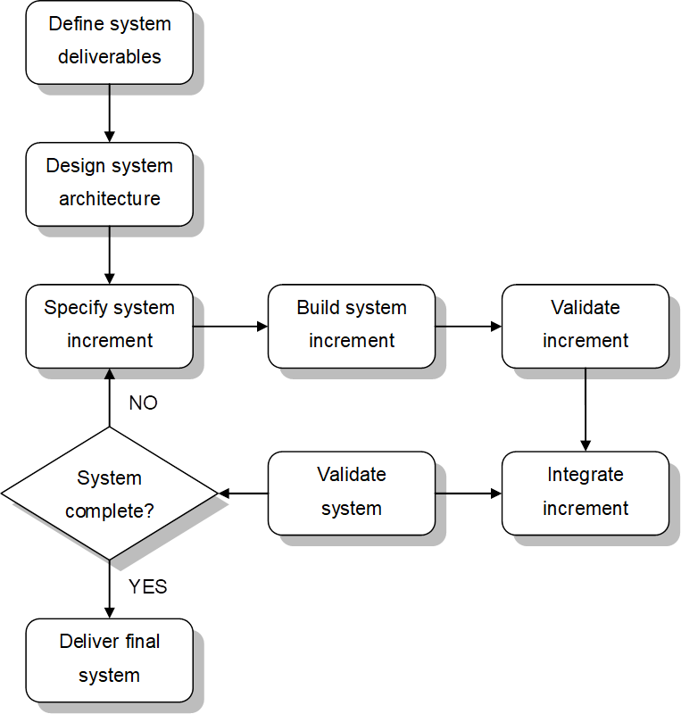
An iterative development process
Figure shows a general process model for increment software development.
The early stage of process focuses on architectural design and then it produces software in increments rather than a single package.
Each process iteration produces a new software increment.

Slide 38
End

